Slide 1

Ticket Price Analysis & Recommendations
Big mountain resort, Mt

Slide 2
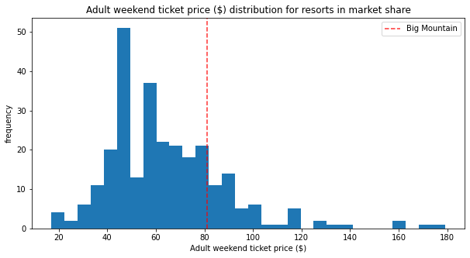
current ticket pricing strategy
Not considered in strategy:
1. Value of current ski lodge facilities
II. Value of added improvements
III. Options for reducing operating costs
Big Mountain Resort (BMR) charges a simple premium (+26.5%) relative to its market segment for lift tickets.
Big Mountain Resort
$81.00/day per adult
Mean Price
Mean Price
Big Mountain Resort
~$64/day per adult
Notes:
Problem Identification I:
Pricing strategy is flawed and inefficient.
How do we know the value added from improvements?
Are we charging the customers the right ticket price based upon BMRs facilities?
How do we know the best way to reduce operating costs when necessary?

Slide 3
current ticket pricing strategy
What if we knew?
I. The optimal price of a ticket at BMR?
II. Which facilities support higher ticket prices?
III. Which facilities can be removed to reduce operating costs?
Big Mountain Resort (BMR) charges a simple premium (+26.5%) relative to its market segment for lift tickets.
Big Mountain Resort
$ ??? /day per adult
Mean Price
Mean Price
Big Mountain Resort
~$64/day per adult
Notes:
Problem Identification I:
What if there were a simple model that could predict the optimal value of a lift ticket at BMR?
A model that could determine which facilities will drive higher revenues?
And also determine where costs can be reduced without sacrificing ticket price?

Slide 4
Recommendation & Key findings
Adopt a ticket price of $92.00/day as supported by current resort features
Annual revenue +$19.25 million annually (+13.5% YoY)
Add a new chair lift and extend a run 150 feet in drop
Net annual revenue +$16.13 million annually (+12.3% YoY)
(Optionally) Close ski run(s) to reduce operating costs
Close one ski run:
+/- $0 revenue annually, -$1.54 million annual operating cost
Notes:
Recommendations & Key Findings:
Fortunately, this model has been developed, based upon its pricing predictions the following changes are recommended at BMR.
Let me walk you through the inputs we used to develop these recommendations.

Slide 5
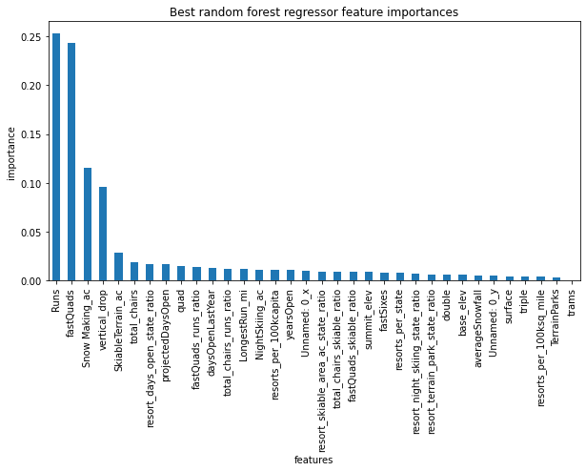
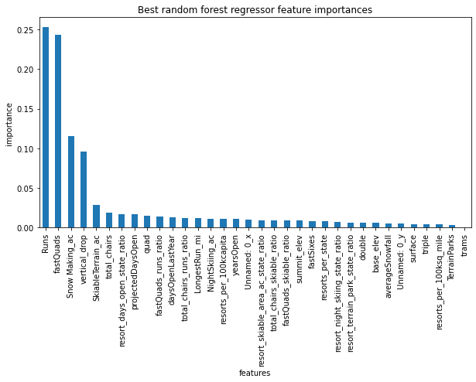
Market research: facility importance to ticket price
National Ski Facilities Dataset
36 Features at 277 Ski Resorts
Random Forest Regression Model (RFRM)
Facility Importance Score
Notes:
Modeling Results & Analysis I:
Raw facilities data from 227 national ski resorts within BMRs market segment was aggregated and cleaned, and feature data (in this case facilities data) was fed into several regression models to predict the facilities most important to supporting a high ticket price.
The most accurate model (the random forest regression model - RFRM) was selected for use in our case, and a hierarchy of facility importance was developed where scores are assigned to facilities most likely to support high ticket prices.
We can see that five or six features in particular have the highest influence on pricing power:
Number of ski runs
Number of fast quad lifts
Snow making acreage
Vertical drop from the highest lift to the base of the lowest run
Skiable terrain
Total number of ski lift chairs

Slide 6
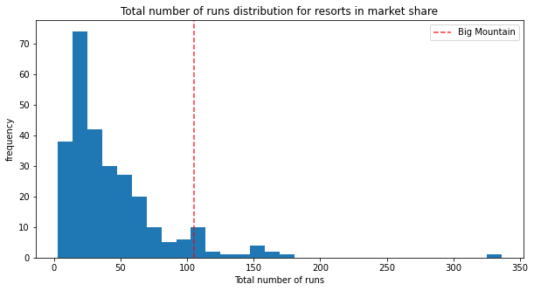
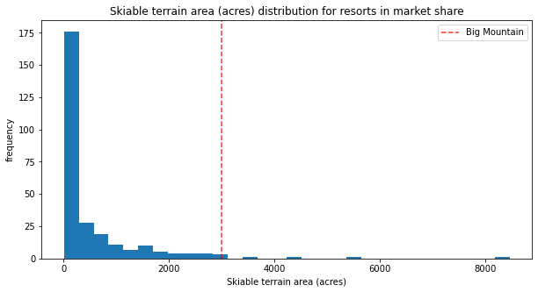
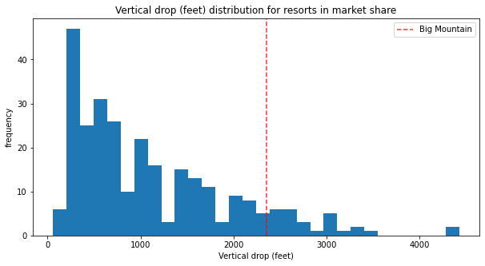
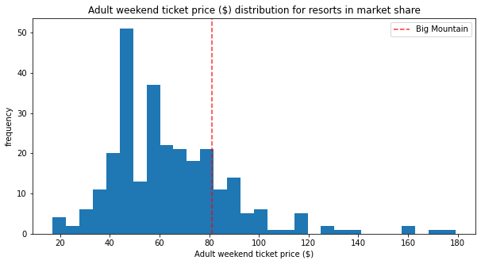
Currently supported ticket price: $92.83 per day
Number of Runs
Skiable Terrain Area
Big Mountain Resort
Big Mountain Resort
Vertical Drop
Adult Ticket Price
Current Price: $82.00
Big Mountain Resort
Modeled Price: $92.83
Notes:
Modeling Results & Analysis II:
Looking through these distributions among national ski resorts, we can see that BMR currently scores well relative to national resorts with regard to facilities with high impact on ticket price (“importance”)
The current “premium” ticket price charged is well below the optimal market value for BMRs facilities
Based upon this discrepancy, the random forest regression model predicts that BMRs facilities currently support a ticket price of $92.83/day or ~$92.00

Slide 7
High impact improvements: $92.83 → $102.93 per day
Which facilities can be added to support a higher ticket price?
Multiple scenario parameter combinations modeled to evaluate effect on ticket price
Highest Impact Scenario:
‘Runs’: Number of ski runs, increase by one.
‘vertical_drop’: total elevation drop from highest lift-serviced point, increase by 150 feet.
‘total_chairs’: number of lift chairs in operation, increase via addition of one ski lift.
Modeled net annual revenue increase: +$16.13 million
Gross annual revenue: +$17.67 million
Annual operating costs: +$1.54 million
Notes:
Modeling Results & Analysis III:
Taking a closer look at actionable improvements with resect to these high impact facilities,
Which facilities should be prioritized to drive higher ticket prices at BMR?
Several models were run with different parameter combinations, outlined here is the highest impact scenario

Slide 8
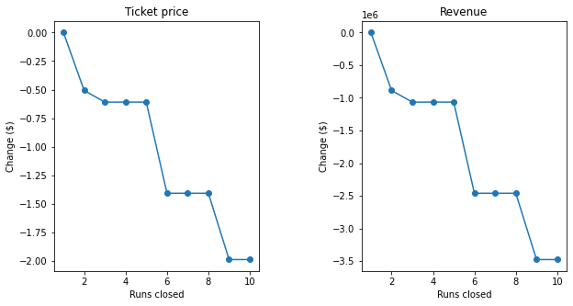
Reducing operating costs
Which facilities can be removed to effectively reduce operating costs?
Ski runs
Two Scenarios:
Decrease number of ski runs by one.
Operating costs: -$1.54 million/year
Net savings: +$1.54 million/year
Decrease number of ski runs by five.
Operating costs: -$7.70 million/year
Net savings: +$6.70 million/year
Notes:
Modeling Results & Analysis IV:
Conversely, in the case that BMR needed to reduce operating costs, our model predicts that ski run closure is the best method for cost reduction
Two scenarios are recommended for cost reduction based upon the needs of BMR:
In the first--less drastic--scenario, our model predicts that a single ski run closure will result in no loss of ticket price support. In other words, operating costs will be saved at the expense of zero revenue change, therefore netting a savings of $1.54 million per year.
In the second—more drastic—scenario, up to five ski runs may be closed resulting in a loss of $1.0 million annually, however, operating costs will be reduced by $7.70 million per year, therefore netting a savings of $6.70 million per year.
As shown on the figure, closure of more than 5 ski runs is modeled to result in significant revenue losses and therefore is not recommended.

Slide 9
Summary & conclusion
Market Data
Predictive Modeling
Key Feature Selection
Optimum Ticket Price
Higher Revenues
BMR can improve its ticket pricing to increase revenues via:
Adopting a data-driven facilities-based approach to ticket pricing
Prioritizing construction of facilities with high impact to ticket pricing
Reducing operating costs when necessary, via closure of ski runs
Notes:
Summary & Conclusion:
In summary, the ticket pricing scheme at BMR can be significantly improved to increase revenues through the following:
- Use of market data and analytics to more accurately price the value of facilities at BMR
Allow for intelligent selection of new facilities to drive higher revenues
Allow for tactical operating cost reduction when necessary to fund new facilities or save on unnecessary expenditures

